Slide 1


FusArt
Web Development
24/11/2023
Oriana Eid (211113)
William Abou Khalil (210241)

Slide 2
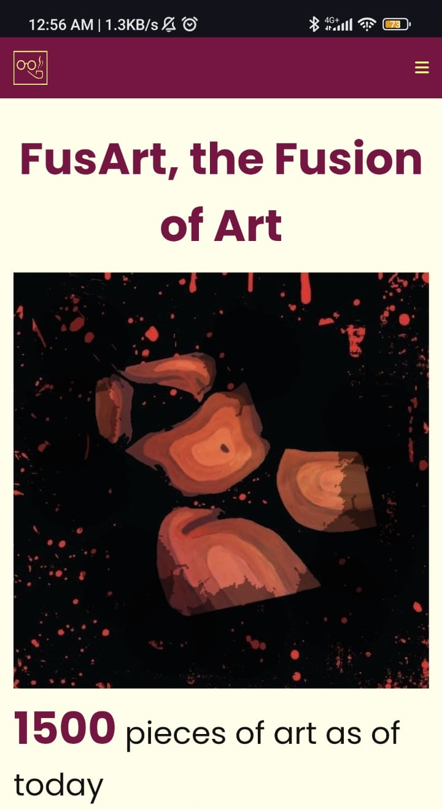
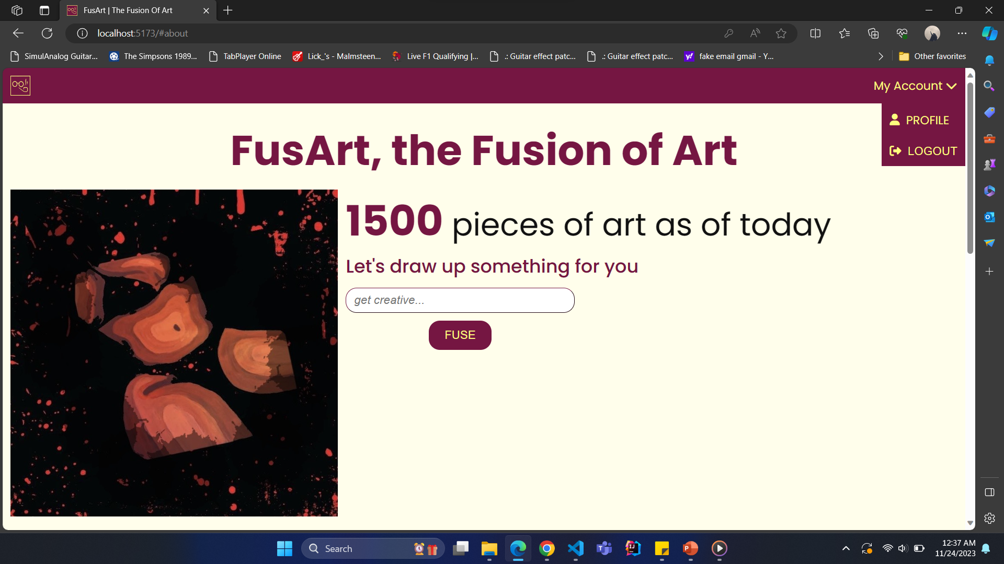
Introduction
FusArt, the Fusion of Art

Slide 3
Problematic
How can artists make a living out of their work in the Middle East?
How can we fight the domination of AI in art?

Slide 4
About FusArt
Solution
Platform for artists to post and sell their work
Encourage artists financially and through acknowledgment
Virtual museum for digital and traditional art
AI model to mix art pieces uploaded on the website

Slide 5
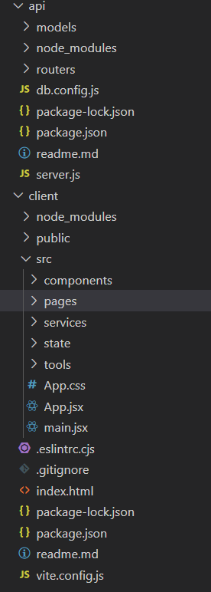
Process
Server.js setup
API routes
MongoDB Atlas and Mongoose
Models and schemas
Controllers
React App
Pages and components

Slide 6
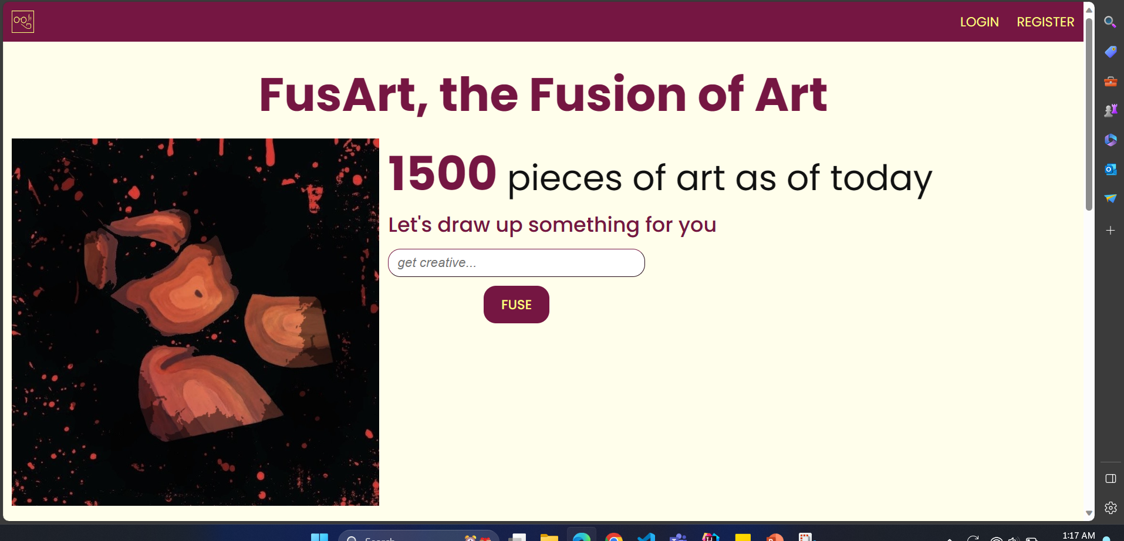
Screens

Slide 7
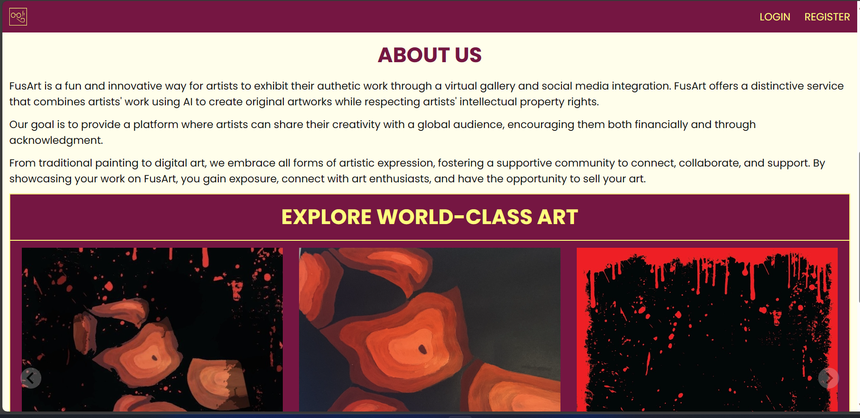
Screens

Slide 8
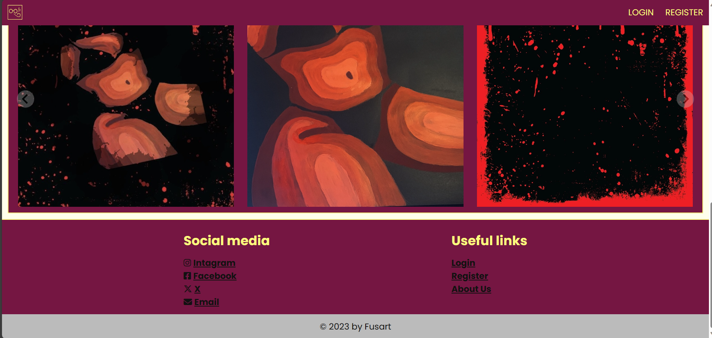
Screens

Slide 9
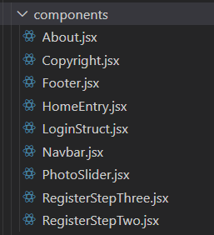
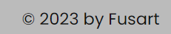
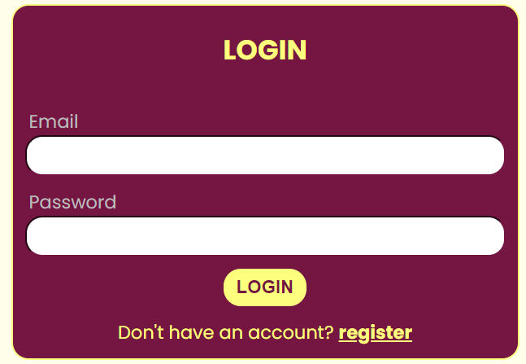
Components
About
Copyright
Footer
HomeEntry: home page with images and search engine
LoginStruct
Navbar: navigation bar, logo, drop down menu
PhotoSlider: display images
RegisterStepThree: user/artist specifies the kind and type of art they’re interested in
RegisterStepTwo: chooses if user/artist and can write an optional biography

Slide 10
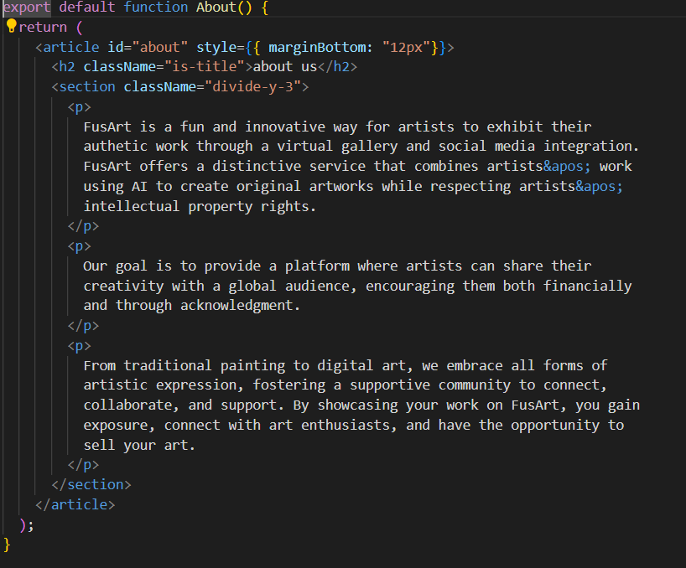
About :
about us text in the home page

Slide 11
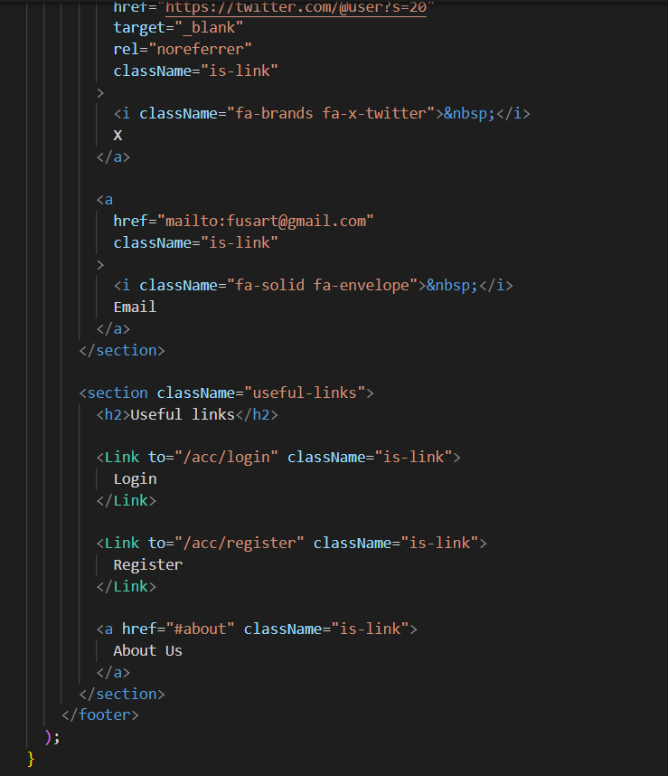
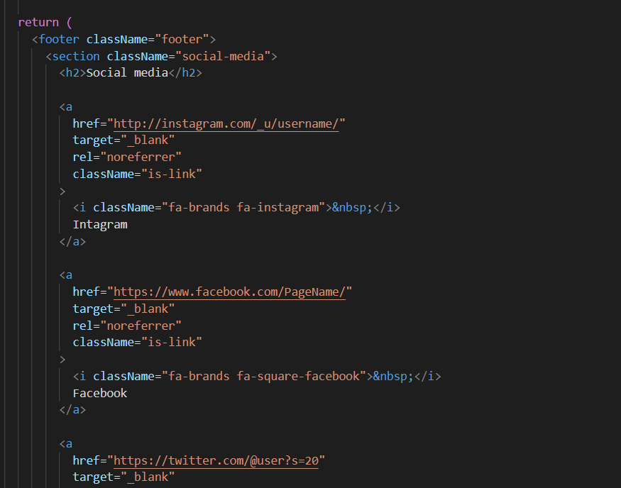
Footer :

Slide 12
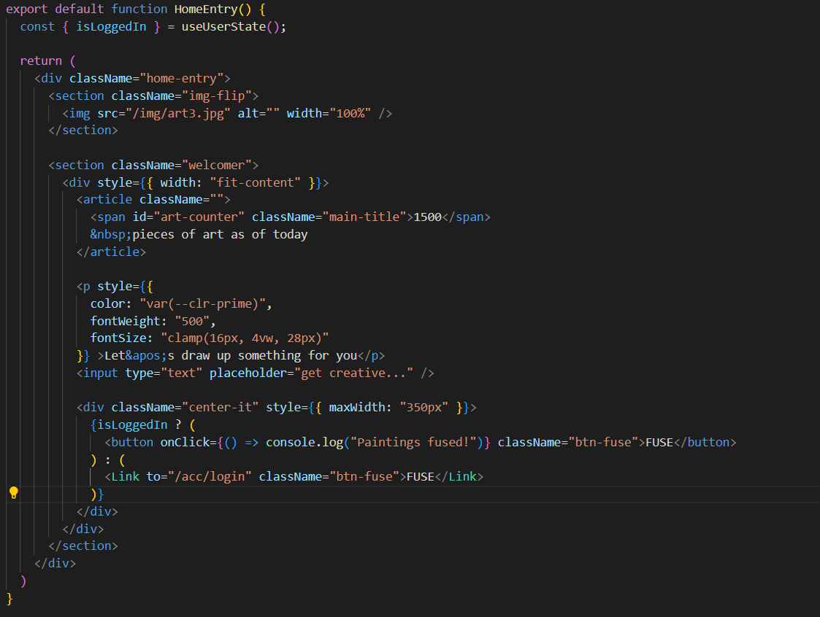
Home Entry :
Flipping image
Counter
Input
Button if Logged in or Not

Slide 13
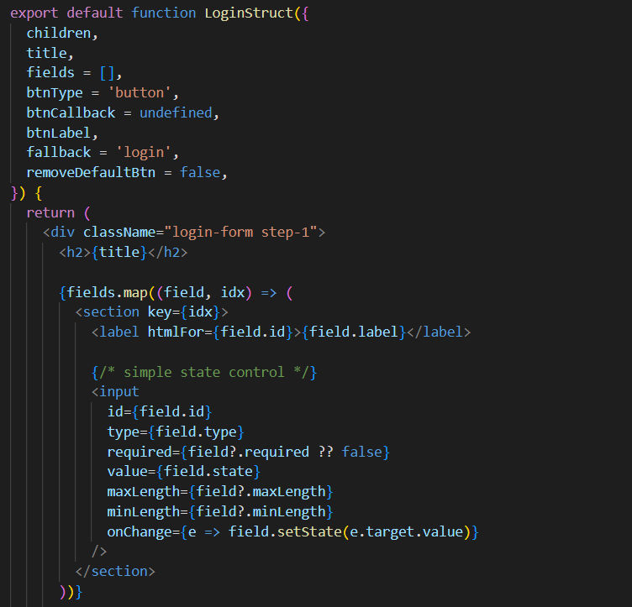
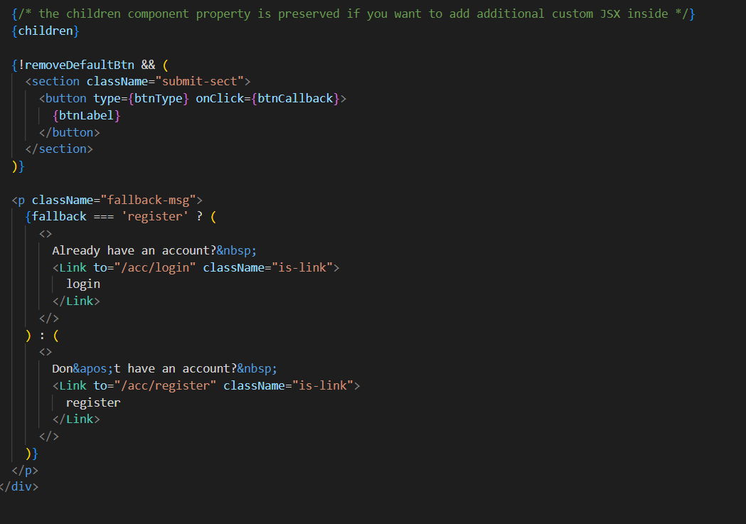
Login Struct :

Slide 14
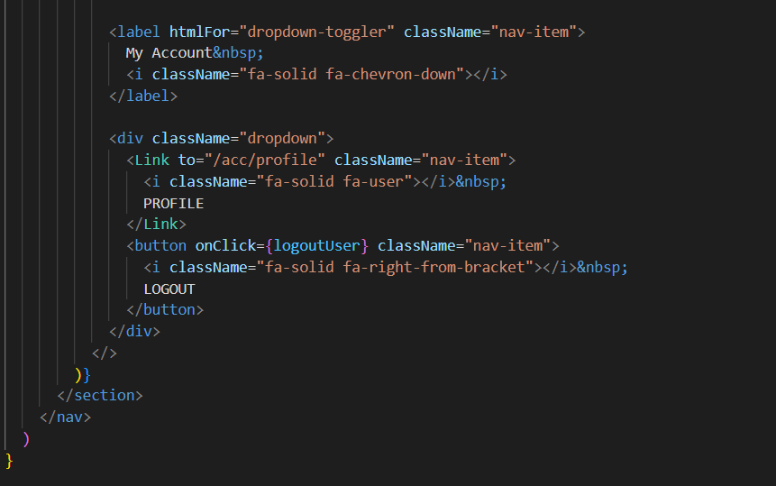
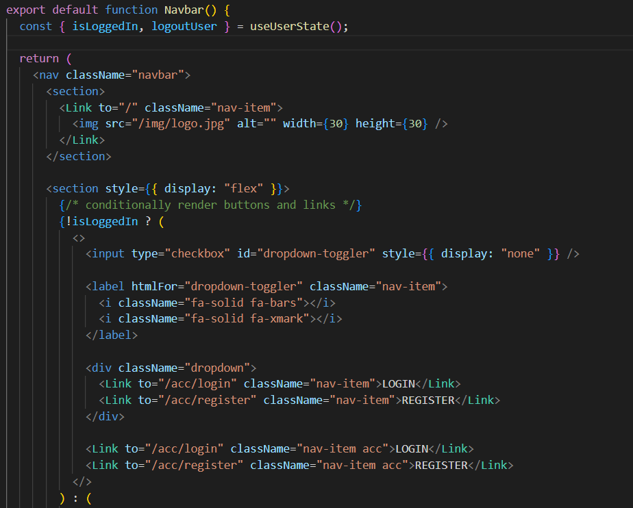
NavBar :
After Login :
Before Login :
Top Bar
Link to login or Register
Profile

Slide 15
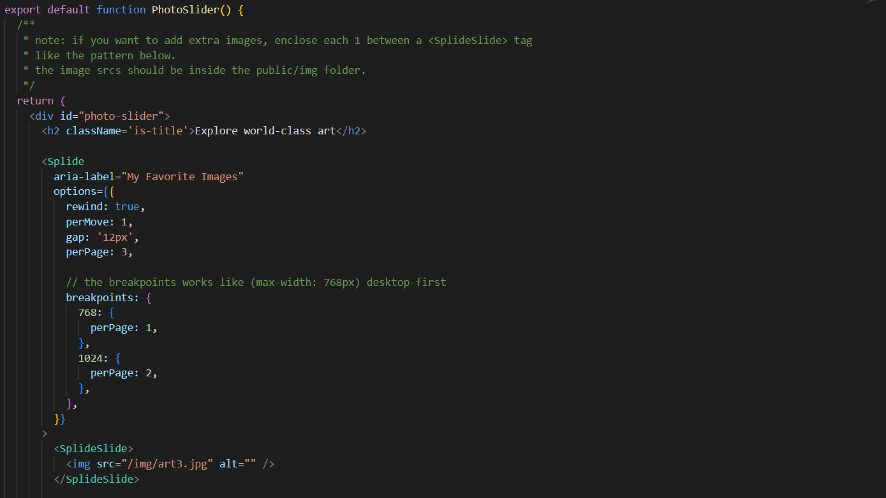
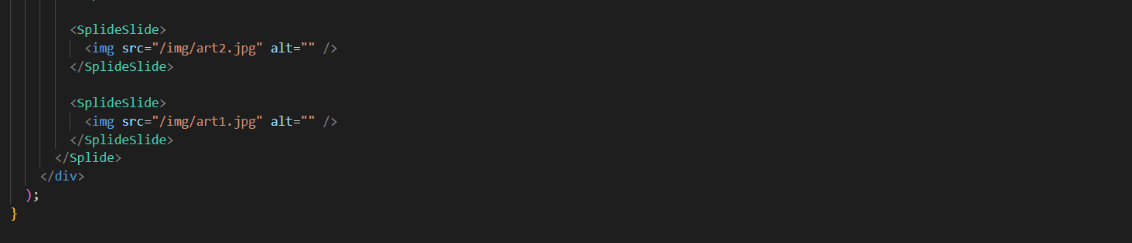
PhotoSlider :

Slide 16
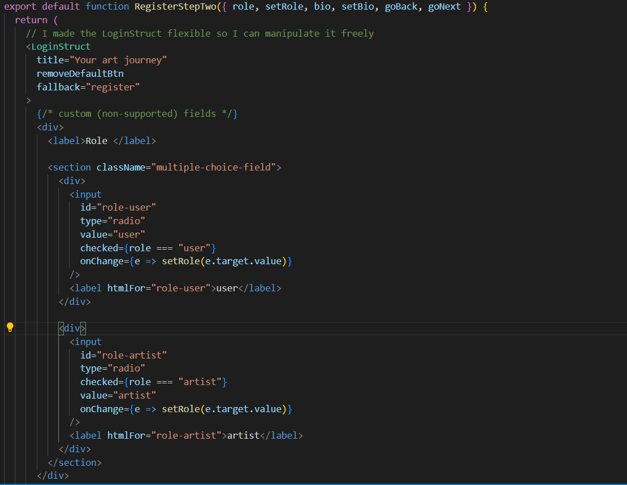
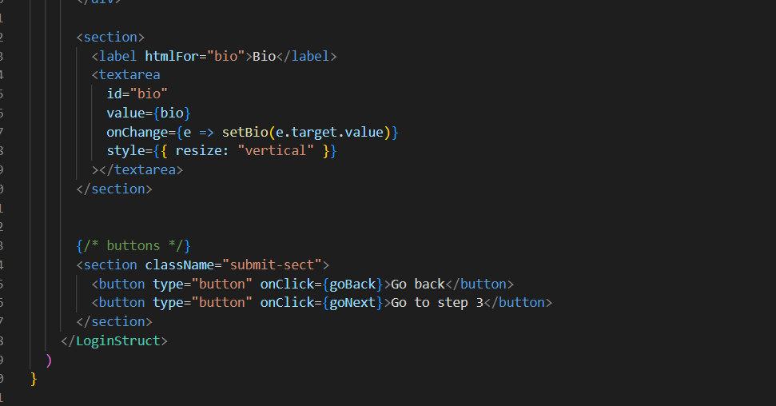
Register Step 2 :

Slide 17
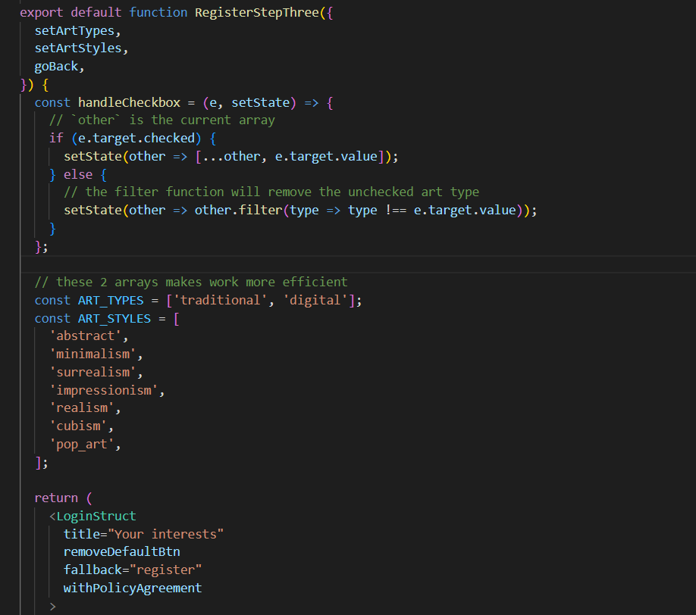
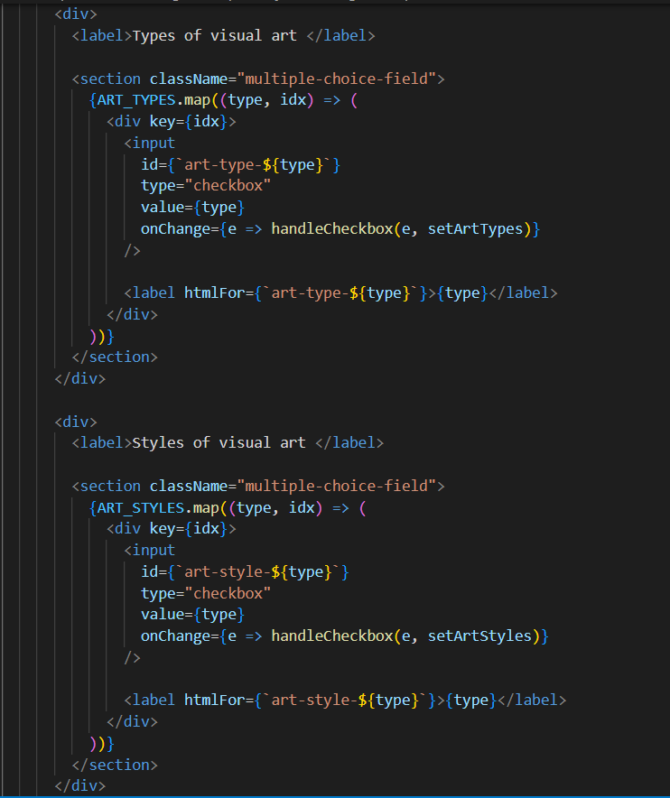
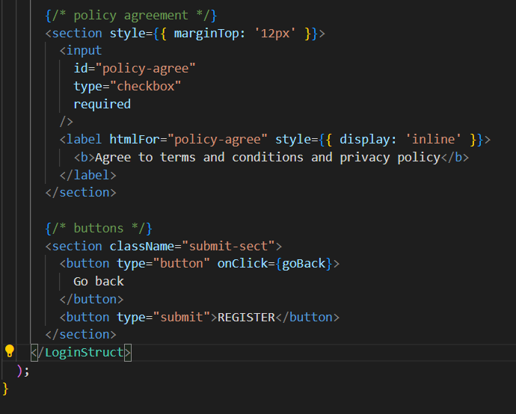
Register Step 3 :

Slide 18
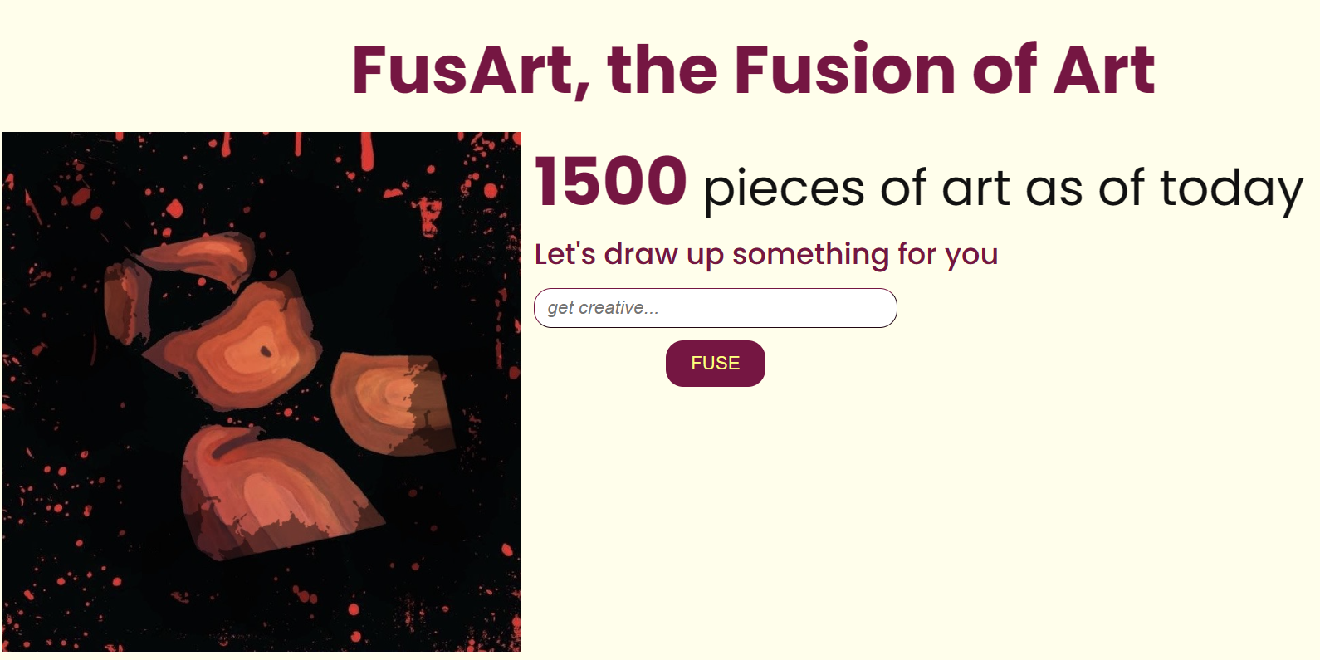
Features
Hero section

Slide 19
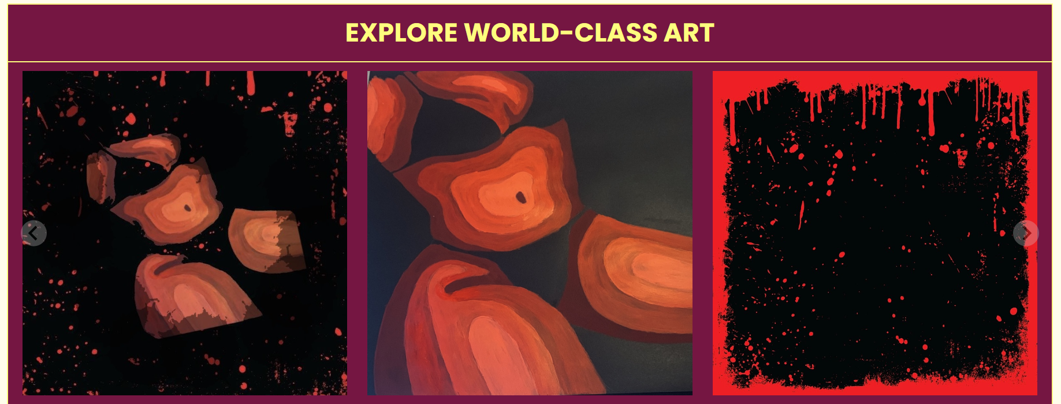
Features
Carousel

Slide 20
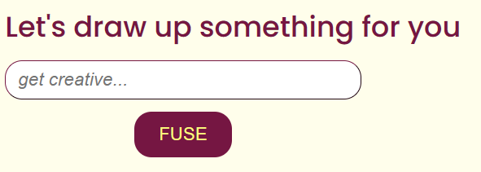
Features
Search engine

Slide 21
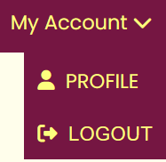
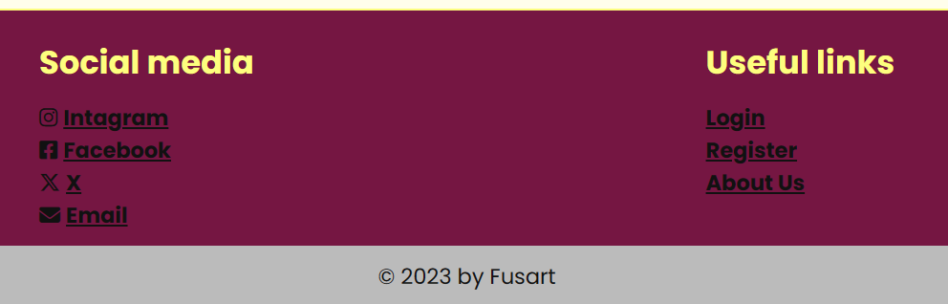
Features
Drop down menu
Footer

Slide 22
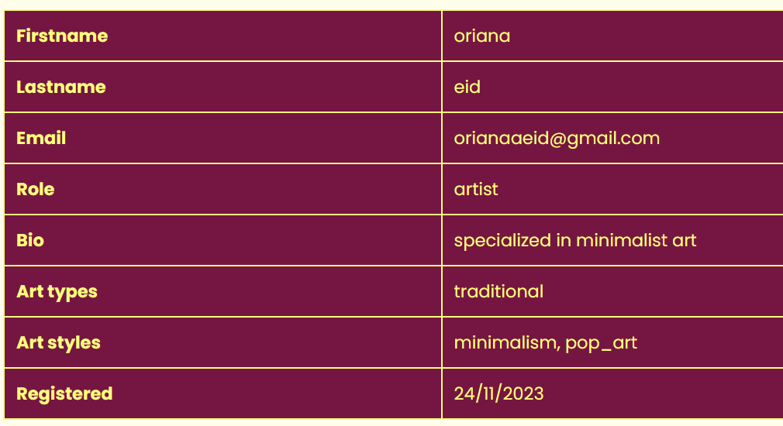
Features
Cards

Slide 23
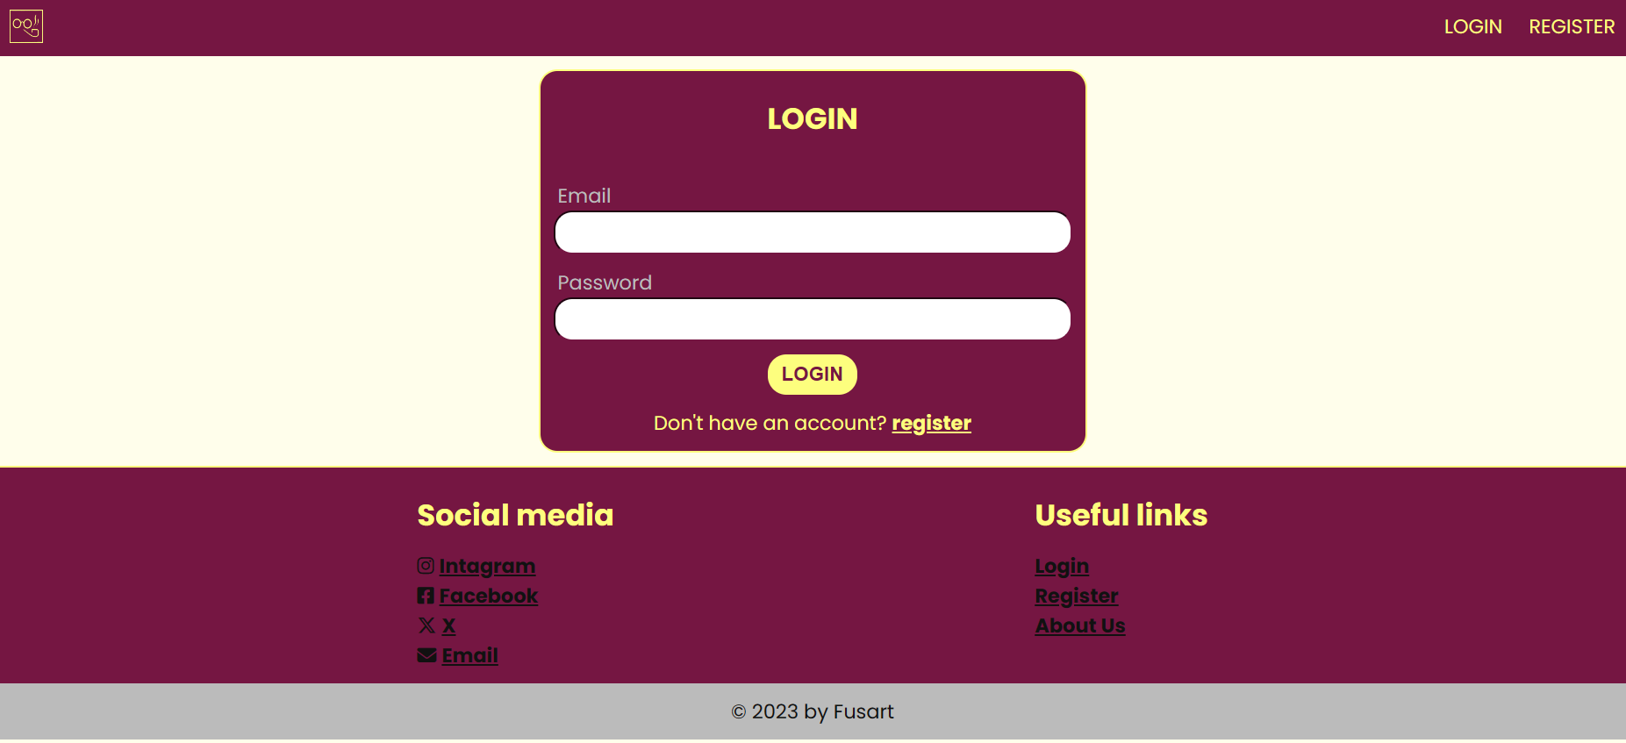
Features
User login

Slide 24
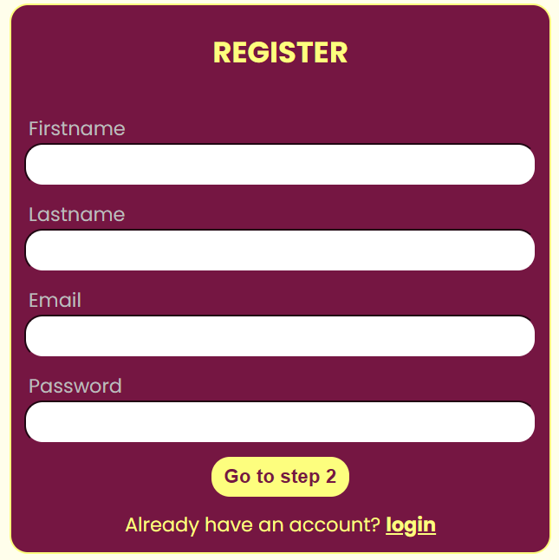
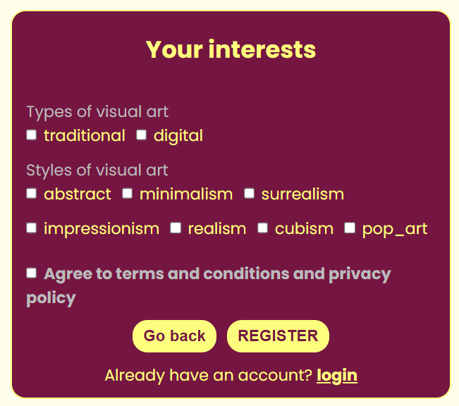
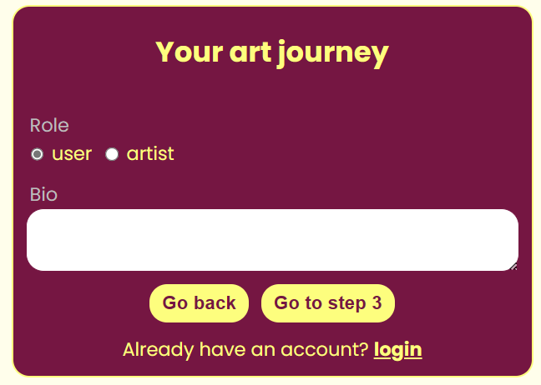
Features
User sign up (with frontend verification)

Slide 25
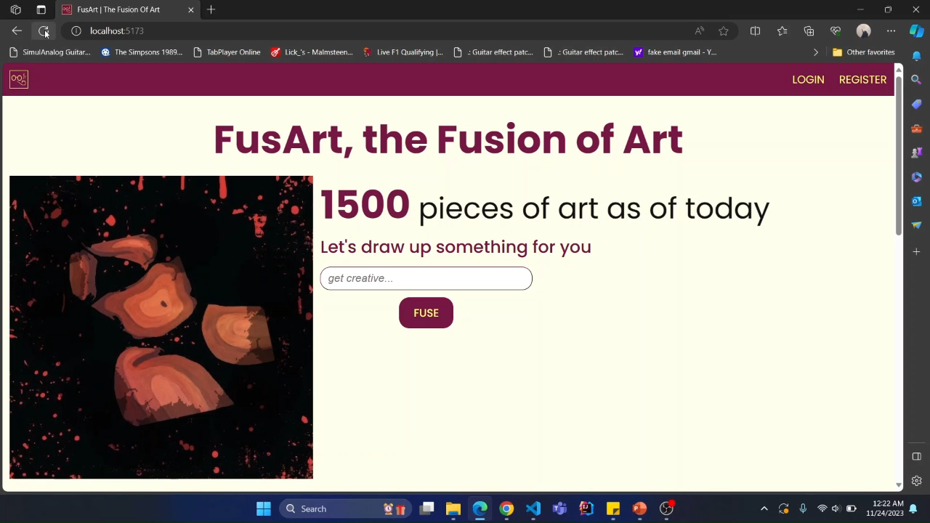
Demo

Slide 26
Conclusion
Need to implement the main feature: AI model
Next course?

